Slide 1

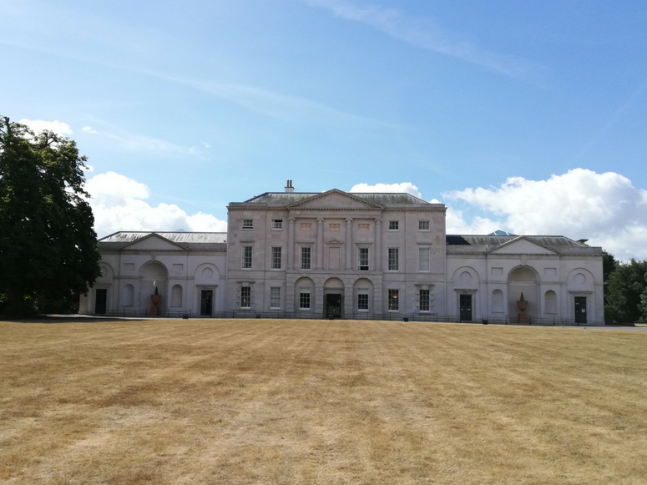
TO LET
HIGH QUALITY SERVICED OFFICES
CAMS HALL, CAMS HILL, FAREHAM, HAMPSHIRE PO16 8AB

Slide 2
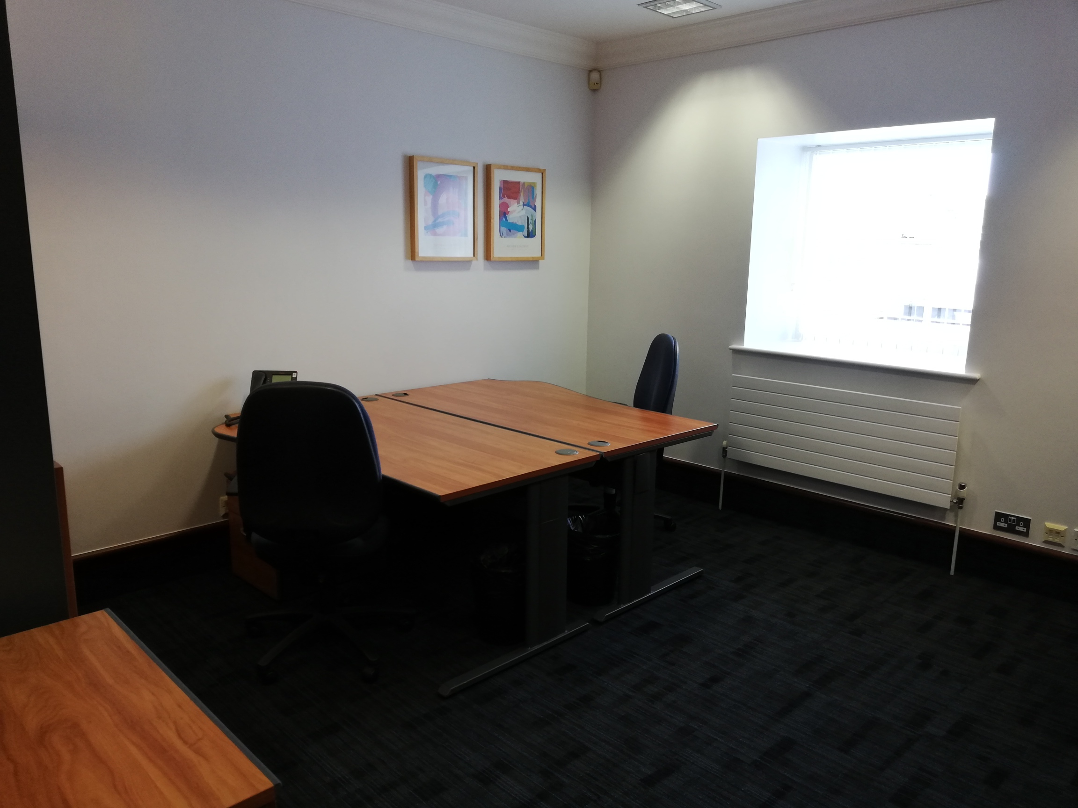
Serviced Offices in Listed Georgian Mansion
Single Monthly Fee with No Hidden Charges
Spectacular Parkland Setting
Extensive On-Site Parking

Slide 3

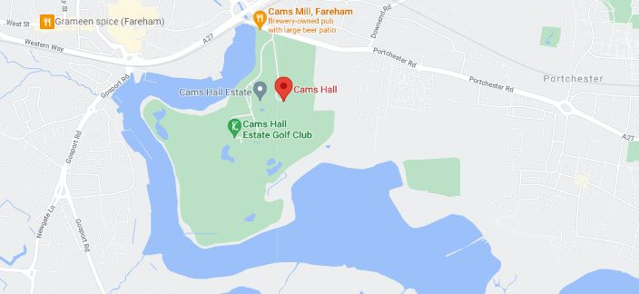
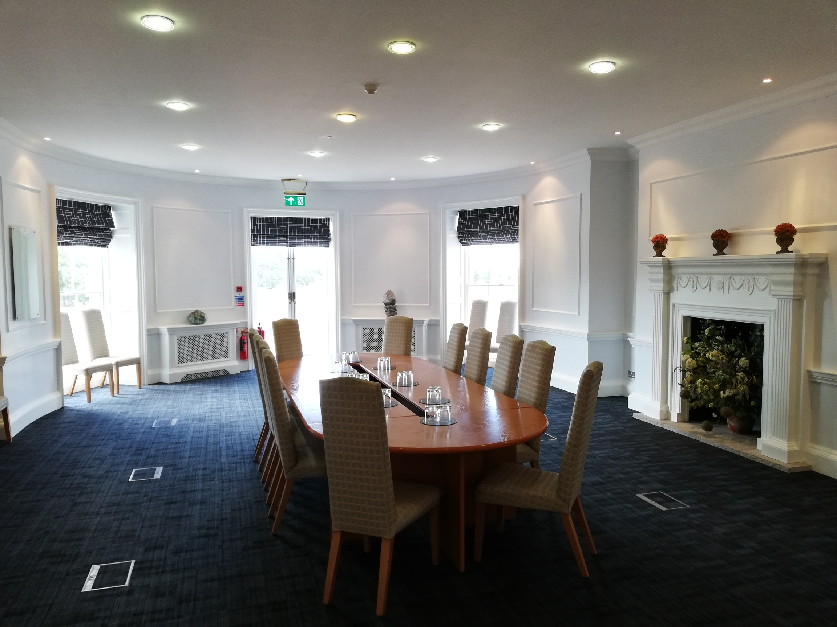
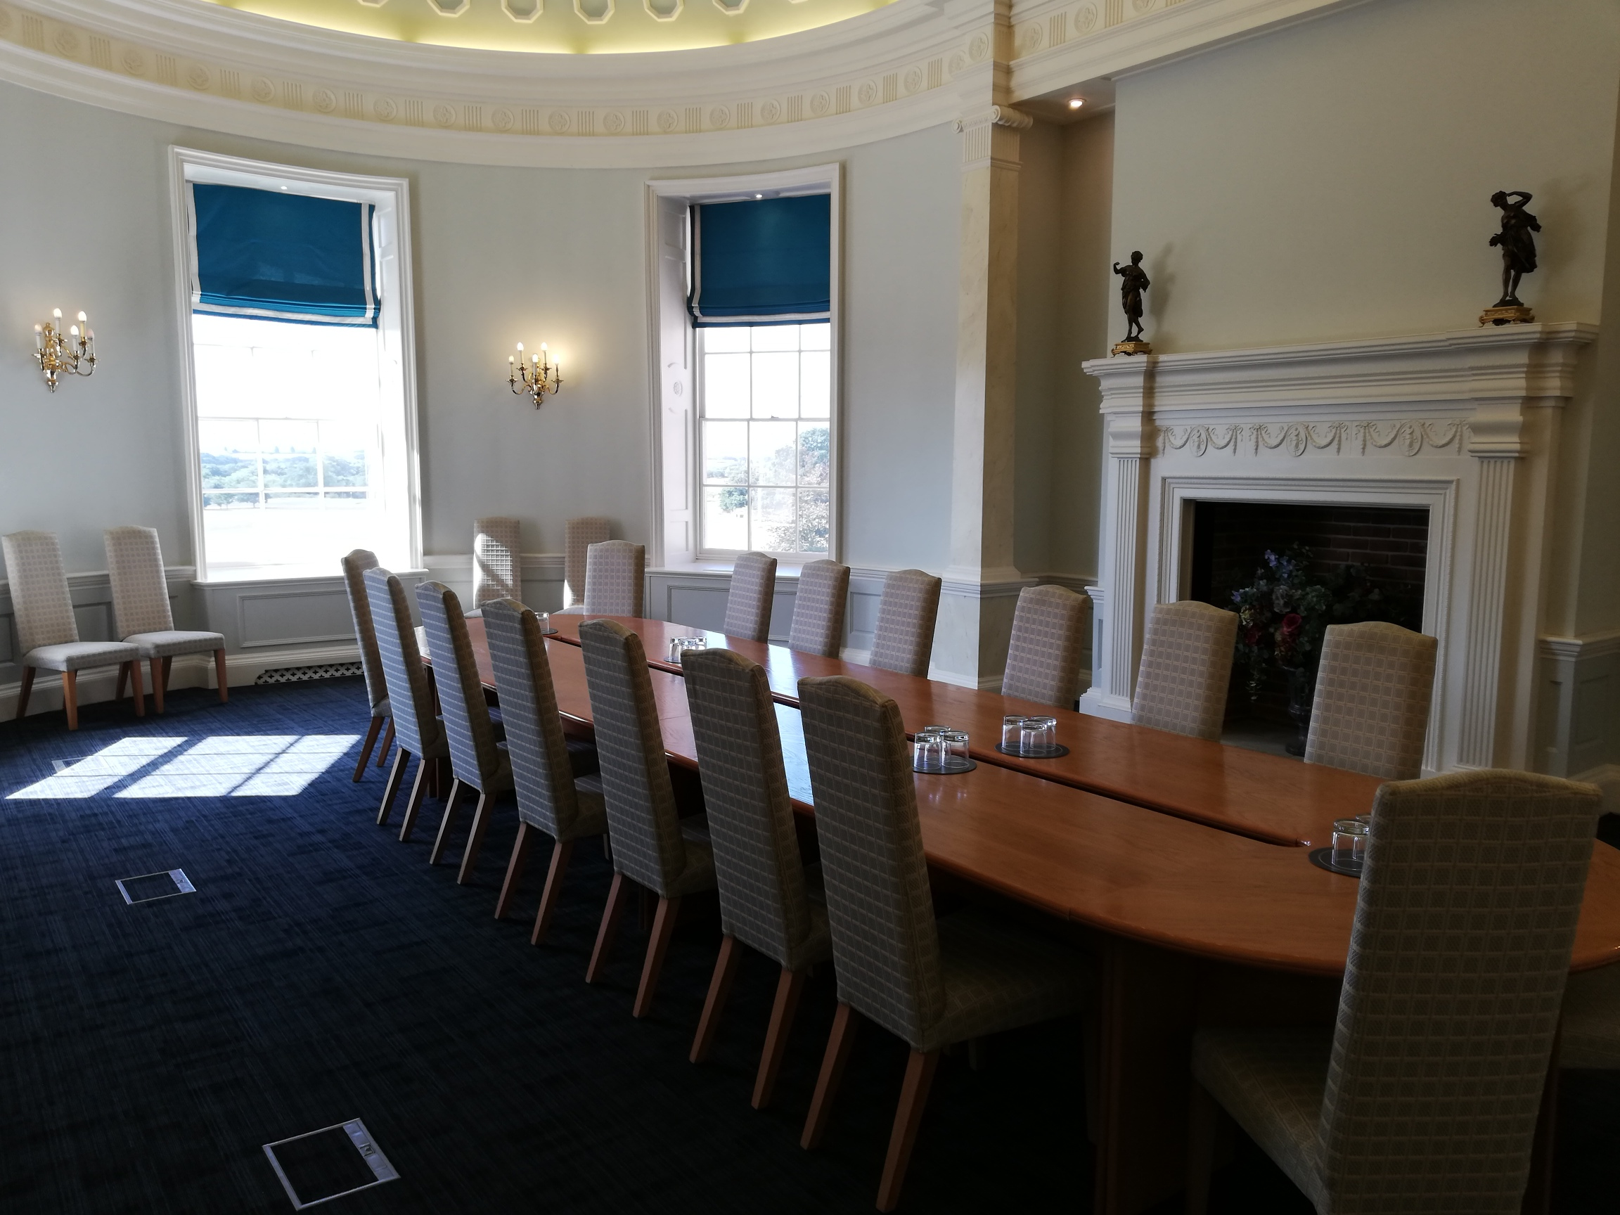
LOCATION
Cams Hall is located between the cities of Portsmouth and Southampton in the attractive town of Fareham. With Unhampered access to the M27, at nearby Junction 11 and Motorway links to London, Cams Hall offers a large catchment area.
DESCRIPTION
Cams Hall is a 300 year old Georgian Mansion with a Portland stone frontage all set on a beautiful parkland setting. With modern recently refurbished service office spaces available capable of accommodating two to fifteen people.
Cams Hall offers admin assistance, the choice of three varying sized meeting rooms as well as high speed internet and fully equipped kitchen facilities with hot and cold drinks.
LICNESES
These offices are available on flexible license terms with a single monthly fee and no hidden charges. All business rates, utilities, service charges, rents and insurances included. There is a central discrete reception which answer calls answered in privacy as well as an on site, hands-on management team.
Offices are priced on a desk-by-desk basis and offer generous sized private suites for each tenant business.
AVAILABLITY
Please contact Owen Isherwood for more information about the latest availability.
EPC
N/A due to Listed Status
LICENSE FEE
£300 per desk per month– subject to license length and other terms.
CONTACT
Sean Bellion-Carey
T: 01483 300 176
M: 07811 343109
E: sean@owenisherwood.com

