Slide 1
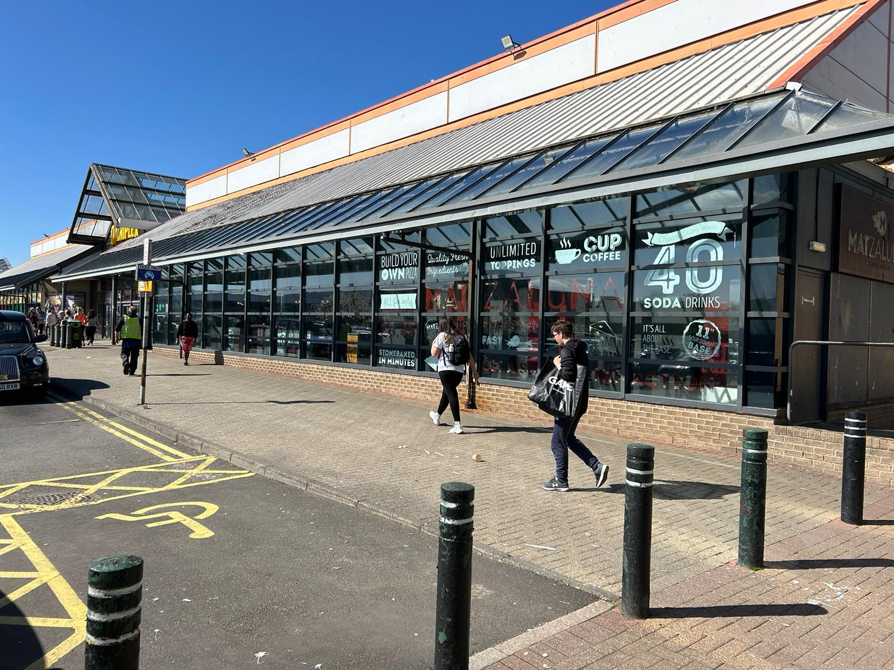

Clydebank
To Let
23A Britannia Way, Clydebank G81 2RZ
2,390 sq ft Fully Fitted Restaurant Unit – To Let
In a Prime Position & Ready To Occupy

Slide 2
23A Britannia Way, Clydebank G81 2RZ
Service Charge & Insurance
The occupier will be liable for a proportionate share of the service charge and insurance. Full details for the 2024/25 budget are available on request.
Lease Terms
The premises is currently available on a new FRI lease.
For full quoting terms, contact the marketing agents.
Planning
The premises falls within Class 3 of the Town & Country Planning (Use Classes) (Scotland) Order 1997.
Interested parties should carry out their own due diligence in this regard.
Business Rates
We understand that the property is assessed as follows:
Interested parties should carry out their own investigations.
EPC
An EPC is available on request.
Legal Costs
Each party is to be responsible for their own legal costs incurred in the transaction.
VAT
VAT will be charged at the standard rate.
Location
Clyde Shopping Centre is a regional retail and leisure destination situated in Clydebank, West Dunbartonshire. Located approximately 15 minutes' drive-time northeast of Glasgow City Centre, Clydebank has a catchment population of approximately 645,000 people within a 30-minute drive time.
Unit 23A occupies an exceptionally prominent position on Britannia Way, located at the entrance of the newly refurbished Omniplex cinema complex.
The location benefits from abundant car parking, excellent access provisions, town centre presence and strong year-round footfall.
Key neighbouring occupiers include; McDonald’s, Nando’s, Domino’s and ASDA.
Size
Accommodation
The premises is arranged over ground floor with excellent frontage totalling approximately 24.95m of floor-to-ceiling height glazing, which presents an excellent opportunity for signage and marketing. The unit also benefits from consistently strong levels of passing footfall.
The unit comprises a fully fitted facility including; dining area, serving facilities, fitted kitchen, male, female, and disabled WC’s.
Access is gained immediately off Britannia Way or through the main foyer area of the Omniplex Cinema.
Dining/Front of House | 1736 sq ft (161.3 sqm)
Kitchen/Back of House | 897 sq ft (83.33 sqm)
Total: | 2390.80 sq ft (222.11 sqm)
Rateable Value: | £25,000
UBR: | £0.498
Rates Payable: | £12,450
Restaurant Premises| To Let

Slide 3
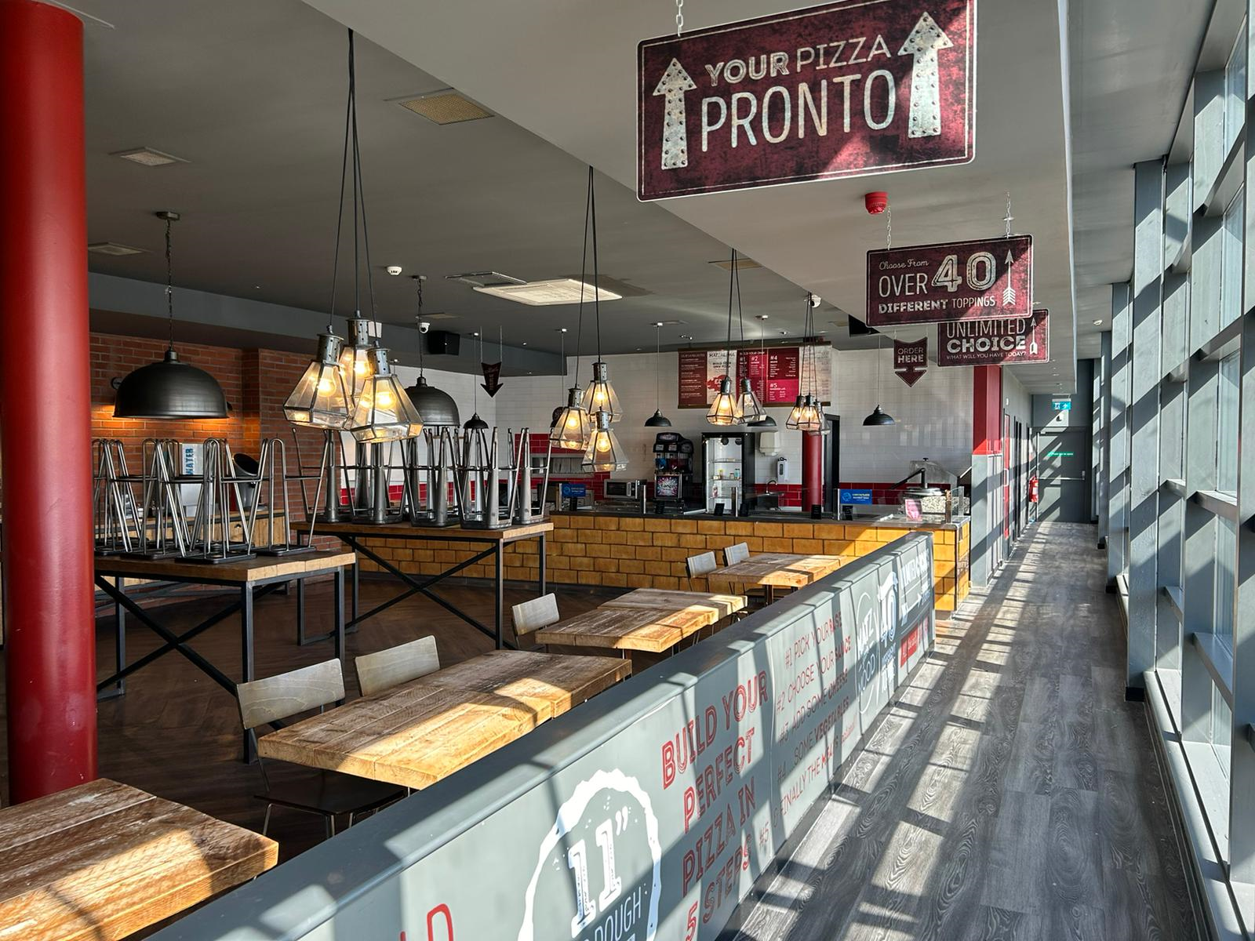
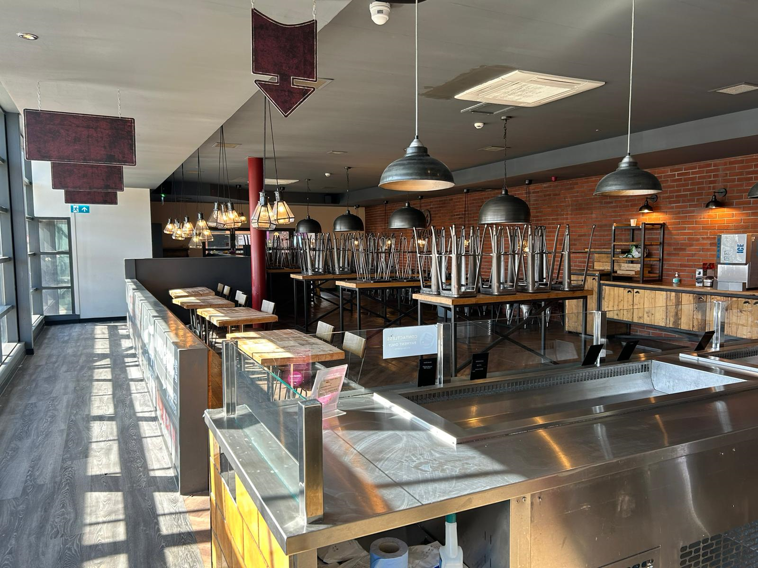
To find out more, please contact us
Pete Harding
+44 (0)7920 812 029
pete.harding@avisonyoung.com
Kara Gillespie
+44 07833435814
kara.gillespie@avisonyoung.com
May 2024
Avison Young hereby gives notice that the information provided either for itself, for any joint agents or for the vendors lessors of this property whose agent Avison Young is in this brochure is provided on the following conditions:
The particulars are set out as a general outline only, for the guidance of intending purchasers and/or lessees and do not constitute an offer or contract, or part of an offer or contract.
All descriptions, dimensions and references to this property’s condition and any necessary permission for use and occupation, and any other relevant details, are given in good faith and are believed to be correct. However, any intending purchasers or tenants should not rely on them as statements or representations of fact but satisfy themselves of their correctness by inspection or otherwise.
No person in the employment of Avison Young, or any joint agents, has any authority to make or give any representation or warranty whatsoever in relation to the property or properties in this brochure.
All prices quoted are exclusive of VAT.
Avison Young shall have no liability whatsoever in relation to any documents contained within the brochure or any elements of the brochure which were prepared solely by third parties, and not by Avison Young.
Anti-Money Laundering: To comply with our legal responsibilities for Anti-Money Laundering, it will be necessary for the successful bidder to provide information necessary to complete these checks before the deal is completed. Information required will include:
Corporate structure and ownership details.
Identification and verification of ultimate beneficial owners.
Satisfactory proof of the source of funds for the Buyers / funders / lessee.
avisonyoungretail.co.uk

