Slide 1
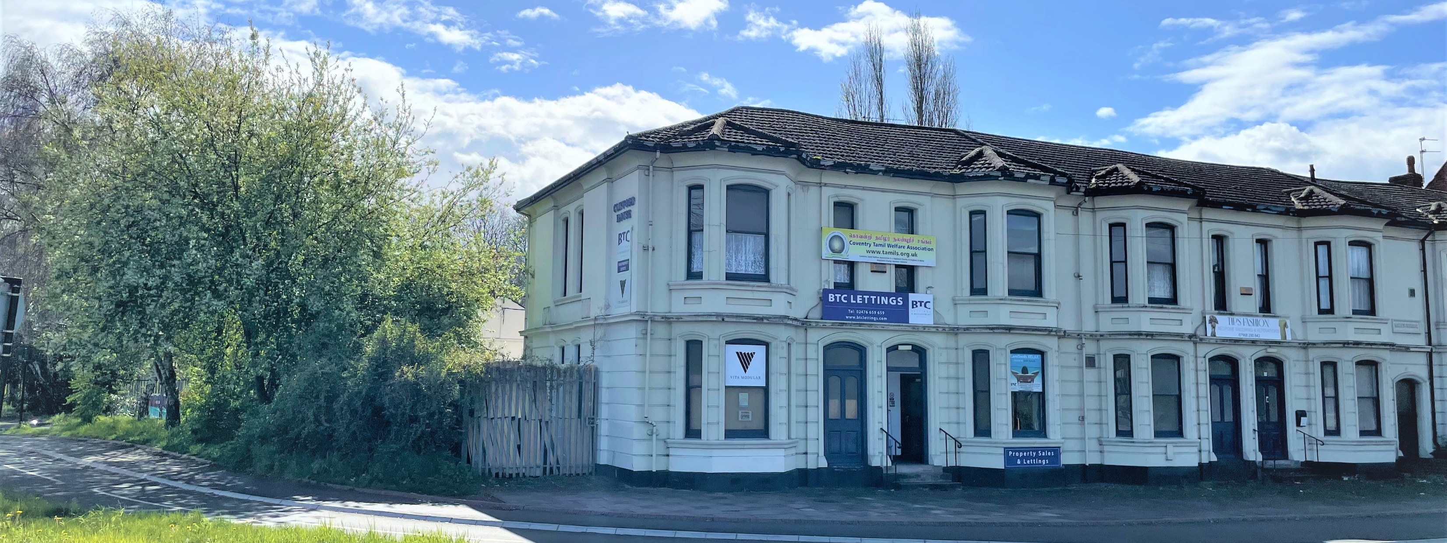

For Sale
Clifford House, Binley Road, Coventry CV3 1JA
Potential Residential/PBSA Development Opportunity (STP)
Lucy Briggs
Joe Williams
Senior Surveyor
+44 (0)121 609 8075
+44 (0)7780 918 848
lucy.briggs@avisonyoung.com
Associate Director
+44 (0)121 609 8820
+44 (0)7736 279930
joe.williams@avisonyoung.com
Henry Sayers

Slide 2
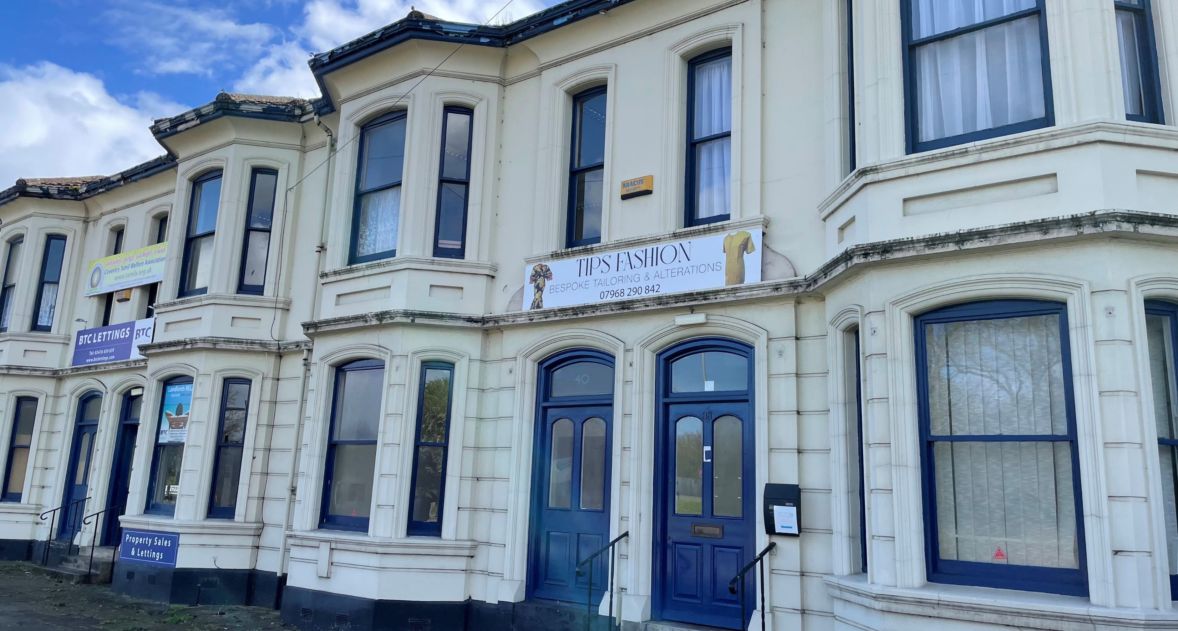
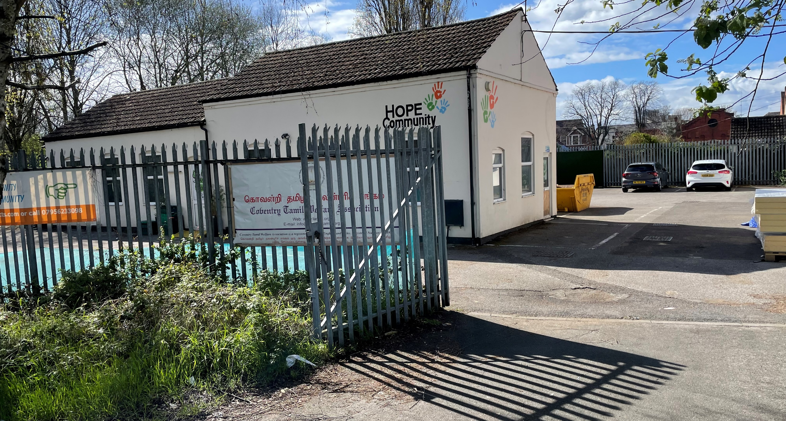




Clifford House
The Site/Opportunity
Clifford House is a two-storey end of terrace building, currently comprising four offices, each with their own street entrance.
The property located on Binley Road, providing a key ‘Gateway’ into Coventry. The property is situated close to the roundabout which connects Binley Road, Jimmy Hill Way (A444) and Humber Road (B4110). A cycle lane runs to the front of the property.
The property appears to be brick with a stone façade and a pitched tiled roof. To the rear is a tarmacadam car park with c. 35 spaces and an additional single-storey office building.
We understand from the Energy Performance Certificates that the building extends to 8,568 sq ft (796 sqm). The property is set in approximately 0.46 acres (0.19 ha).
The property has the benefit of positive pre-application advice, with the Council supportive of the property being redeveloped as a ‘Gateway’ site.
Freehold property with excellent transport links
Approx. 0.46 acres (0.19 ha)
Suitable for a variety of uses, including Residential or PBSA (STPP)
Established residential area
Avison Young | For sale - Clifford House, Coventry

Slide 3
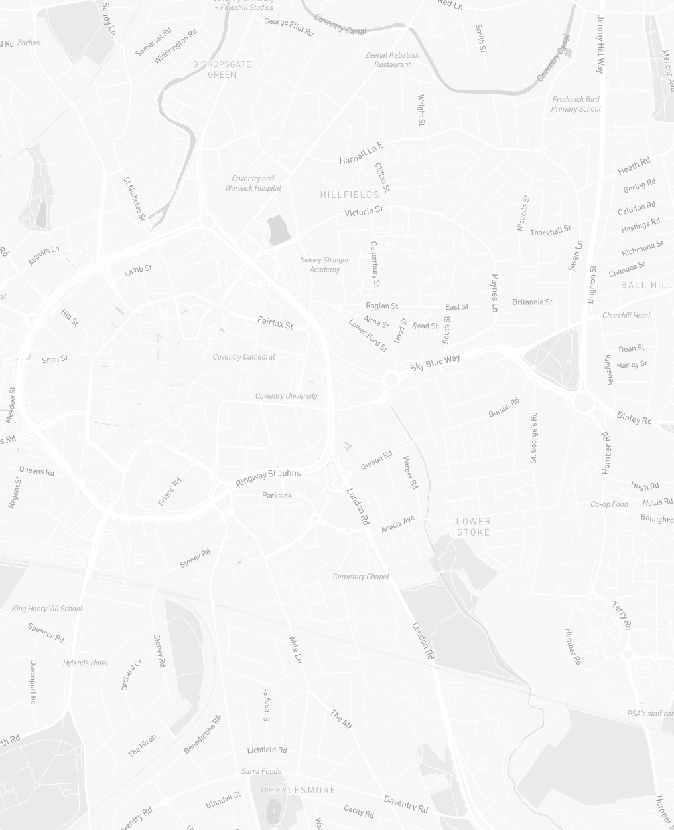
Location
Map
Transport and Local Area
The property is located on the corner of Binley Road, providing a key ‘Gateway’ into Coventry city centre. The property is situated next to the roundabout which connects Binley Road, Jimmy Hill Way (A444) and Humber Road (B4110). Binley Road provides access to the City’s Ring Road (A4053), less than 1 mile to the west while the A444 leads to Burton upon Trent, via Nuneaton.
Coventry is approximately 17 miles (27 km) south-east of Birmingham, 21 miles (35 km) south-west of Leicester and 28 miles (46 km) to the north-west of Northampton.
Coventry railway station is 1.1 miles (1.8 km) to the south-west and has regular services to London Euston, Birmingham International, Birmingham New Street and Northampton amongst other stations.
There are a number of bus stops within 0.3 miles (0.5 km) of the property which provide services to Coventry city centre, Rugby and Willenhall.
Junction 2 of the M6 and M69 is located 3.4 miles (5.4 km) to the north-east of the property.
Key
Clifford House
Coventry University
Coventry Railway Station
Coventry Cathedral
Avison Young | For sale - Clifford House, Coventry

Slide 4
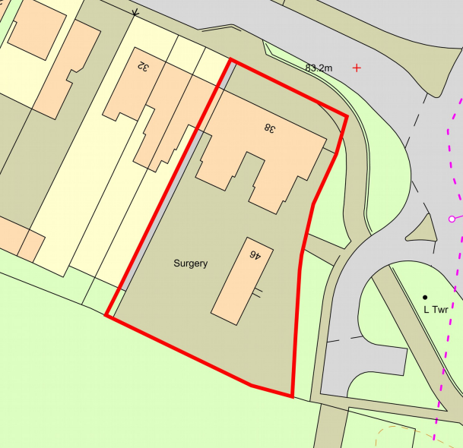
Property detail
Tenure
The property is currently occupied on short term agreements with a passing rent of approximately £60,000 per annum. The property is to be sold freehold with vacant possession and subject to all third-party rights, easements and statutory designations currently passing. Prospective purchasers must satisfy themselves in this regard.
The property currently comprises five freehold titles (ref.: WM125820, WM97263, WK27606, WK144186, MM376) extending to a total of circa 0.46 acres (0.19 ha) gross.
Services and Highways
We understand that all mains services are available to the property however, prospective purchasers must satisfy themselves in respect of the availability, capacity and sustainability of all services and utilities.
Floor Areas
According to the Energy Performance Certificate, the property measures 8,568 sq ft (796 sqm).
EPC
An Energy Performance Certificate dated 9th January 2018 shows a rating of D-90.
VAT
All offers are to be exclusive of VAT which may apply.
Avison Young | For sale - Clifford House, Coventry

Slide 5
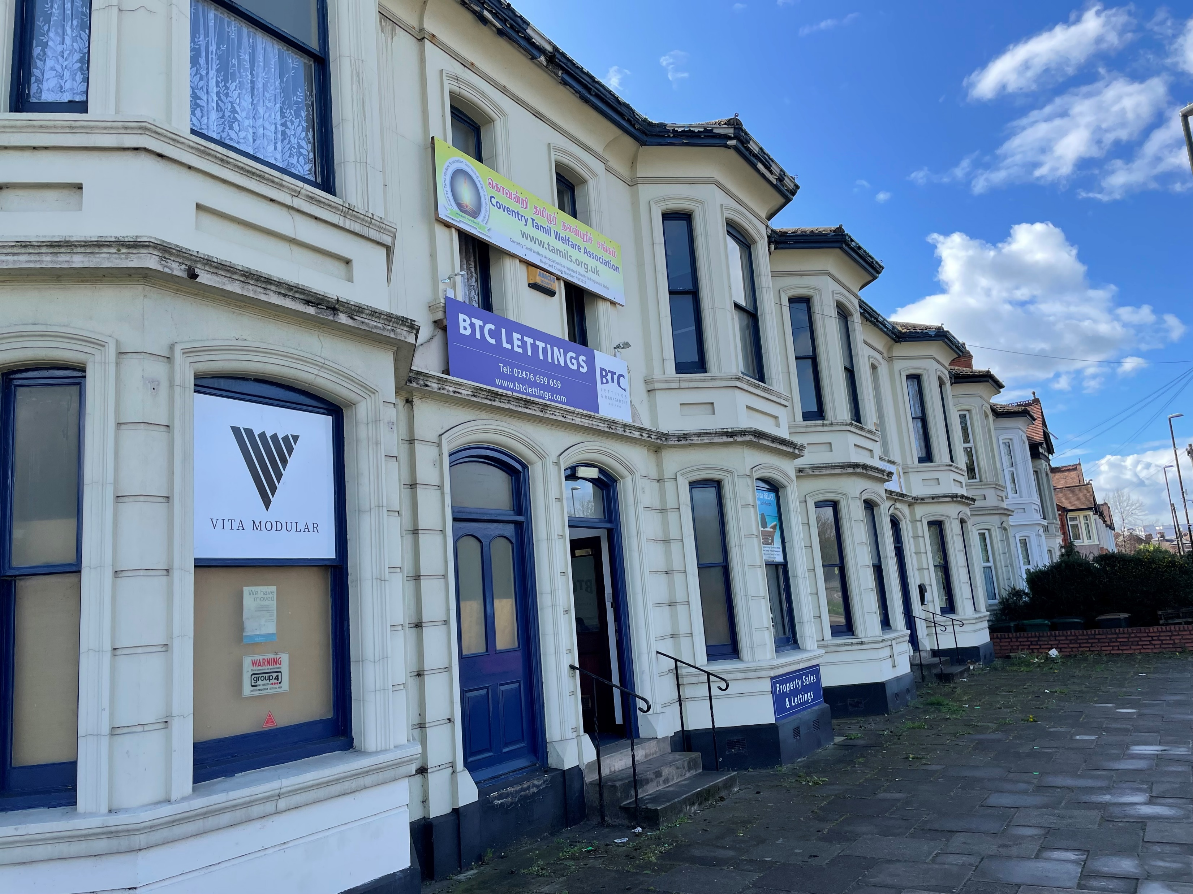
Property detail
Planning
The Local Planning Authority is Coventry City Council with planning policies contained within the Coventry Local Plan (2011-2031).
The current planning use is Commercial, Business & Service (E) however the vendor has had pre-application advice from the local authority which is broadly positive for the development of student accommodation at the site.
Architects’ plans are available in the data room showing two potential schemes comprising the following:
Redevelopment to form 80 residential apartments
Redevelopment to form 186-bed student accommodation
The property may also suit conversion of the existing buildings. Floor plans are included within the data room of the existing accommodation.
Please note that the redevelopment plans are for illustrative purposes only and that no planning permission is currently in place for the conversion/redevelopment of the property.
We recommend that all interested parties carry out their own due diligence and enquiries of Coventry City Council to determine potential schemes at the site.
Viewings
All parties wishing to inspect the property are required to make prior arrangements with Avison Young.
Avison Young request that interested parties do not attempt to gain access to the property outside of accompanied viewing inspections.
We would request discretion in the event interested parties undertake any roadside inspections of the property.
Avison Young | For sale - Clifford House, Coventry

Slide 6

Method of sale
Technical Data Room
Further information in respect of the property is available in the dedicated technical data site available via the Avison Young website: www.avisonyoung.co.uk/cliffordhouse
The technical data room has been compiled by Avison Young in their capacity as advisers to the Vendors. This has been compiled from information supplied by the Vendors and information available in the public domain. The technical information is provided solely for use by recipients in considering their interest in submitting an offer for the acquisition of the Property.
Please be advised that plans, drawings and other information on the data site are protected by copyright, patent and warranty laws.
The information provided should be used for consultations and illustrative purposes only. Therefore, no reliance should be placed on the information or further copies made without the permission of the copyright owner.
Basis of Offers
Offers are to be submitted in writing by 12 noon on 23rd June 2023, together with any supporting information to the selling agents:
lucy.briggs@avisonyoung.com
joe.williams@avisonyoung.com
Interested parties are permitted to submit an offer on more than one basis. Our client reserves the right not to accept the highest or any offer received.
Avison Young | For sale - Clifford House, Coventry

Slide 7
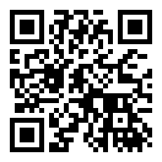
For more information
about this property,
please get in touch.
Avison Young hereby gives notice that the information provided either for itself, for any joint agents or for the vendors lessors of this property whose agent Avison Young is in this brochure is provided on the following conditions:
The particulars are set out as a general outline only, for the guidance of intending purchasers and/or lessees and do not constitute an offer or contract, or part of an offer or contract.
All descriptions, dimensions and references to this property’s condition and any necessary permission for use and occupation, and any other relevant details, are given in good faith and are believed to be correct. However, any intending purchasers or tenants should not rely on them as statements or representations of fact but satisfy themselves of their correctness by inspection or otherwise.
No person in the employment of Avison Young, or any joint agents, has any authority to make or give any representation or warranty whatsoever in relation to the property or properties in this brochure.
All prices quoted are exclusive of VAT.
Avison Young shall have no liability whatsoever in relation to any documents contained within the brochure or any elements of the brochure which were prepared solely by third parties, and not by Avison Young.
Anti-Money Laundering: To comply with our legal responsibilities for Anti-Money Laundering, it will be necessary for the successful bidder to provide information necessary to complete these checks before the deal is completed. Information required will include:
Corporate structure and ownership details.
Identification and verification of ultimate beneficial owners.
Satisfactory proof of the source of funds for the Buyers / funders / lessee.
Lucy Briggs
Senior Surveyor
+44 (0)121 609 8075
+44 (0)7780 918 848
lucy.briggs@avisonyoung.com
Joe Williams
Associate Director
+44 (0)121 609 8820
+44 (0)7736 279 930
joe.williams@avisonyoung.com
avisonyoung.com

